Slide 1
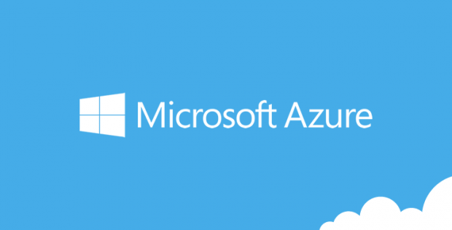

Slide 2
Microservices with Service Fabric
Making dev’s life easier

Slide 3





@g_arora
Gaurav is Microsoft Most Valuable Professional , an author, Mentor and a technology enthusiast with more than 19 years industry experience.
Gaurav Arora
Trends: #GAB2018 #GlobalAzure #IndiaMentor #Azure

Slide 4
Agenda
What, why, when of dev’s life
Lets make our life easier – here are microservices
Service Fabric – makes dev happy
Microservices in Service Fabric – dev’s life is so easy
Demo

Slide 5
introduction
Notes:
At the start – give idea about the current development industry with various aspects of development including CI CD.

Slide 6
What, why, when of dev’s life
Alex Soto who is a medical device analyst has defined developer’s life in a visual way. Thanks Alex for speaking on the reality. In his article, he tried to visualize: https://dzone.com/articles/reality-developers-life-gifs
Production environment is always a pain
Bug, bug and bug
When you tried to be a Singham (an Indian movie’s hero)
Senior took the credit of work
And many more.
Notes:
Open url: https://dzone.com/articles/reality-developers-life-gifs and interact with the devs

Slide 7
Microservices
Notes:
At the start – give idea about the current development industry with various aspects of development including CI CD.

Slide 8
Let’s make our life easier
We, devs are working in a manner that could be located in different geographical zones, in different teams for same project or any other combination of work. Sometime this is very tough to coordinate with each other or say there’s a sync problem chances between devs.
Notes:
Correlate – pain areas of dev’s life and give download how these can be resolved with the help of microservices

Slide 9
What is microservice?
Microservices is an architectural style is new buzz world that has following characteristics:
A big project/application can be divided into small pieces of independent services
Services are independent and loosely coupled
Every service project is purely independent from other service project – as it contains its own configuration, styles etc. and can be manageable by small teams
Services can be built on different framework or language e.g. if Service A is written in .NET Core that does not mean that Service B should be written on .NET Core
These services communicate with each other
Notes:
Just give the overview of microservices and correlate the characteristics of microservices with previous slides. Ref: http://microservicesfor.net/microservices-at-a-glance/

Slide 10
Microservices: Benefits for Dev
There will be more benefits apart from mentioned below:
Knowledge Transfer
Code/Components
Deployment
Technology Choice
Scaling
Notes:
Refer to Blog post: https://blogs.msdn.microsoft.com/azuredev/2018/03/30/why-a-developer-should-build-a-solution-with-microservices/

Slide 11
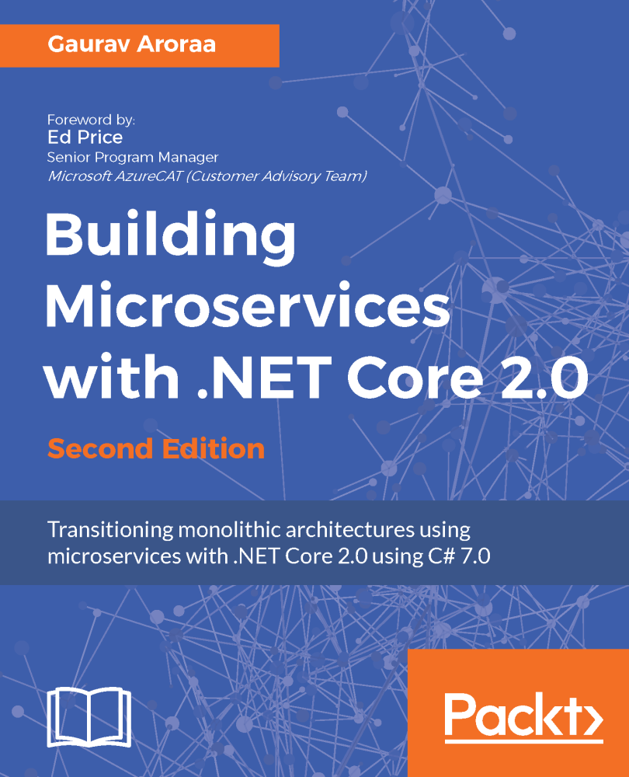
Building microservices
I have authored a book and you would like to read it.

Slide 12
Service Fabric

Slide 13
Making dev’s life easy
Service Fabric is a distributing system platform that is an open source under MIT License. On March 14, 2018 (on PI day) , Service Fabric team blogged about this news: https://blogs.msdn.microsoft.com/azureservicefabric/2018/03/14/service-fabric-is-going-open-source/
Main highlight of Service Fabric is that it can run on Windows and Linux or on your laptop or on cloud besides any geographical locations.
It enables devs to build and manage scalable applications. It empowered many more services viz. Azure SQL DB, Azure Cosmos DB, Azure Event hub etc.
Notes:
Give an overview of Service Fabric using link: https://docs.microsoft.com/en-us/azure/service-fabric/service-fabric-overview

Slide 14
Making BUSINESS EFFECTIVE
With Cloud – things have changed. And in some ways – cloud was born out of the need for this change.
Time To Market
High Availability
Scalability
These are all the more important and define your business and development strategy. Frameworks and Databases are secondary now.

Slide 15
Why Microsoft fabric
As discussed earlier about Microservices - first step is converting humongous applications into: 1. fine grained , 2. loosely coupled services 3. that can individually
scaled and
updated
as required.
Question – If all is so easy then why is Fabric required?

Slide 16
Why Microsoft fabric
There is plenty of pain to be dealt with when writing Microservices. The most critical areas are
Inter Service communication
Failure Handling
Just imagine a set of 15 Microservices – running 15 instances each and each maintaining its data set.
Question - What are the scenarios that you feel are possible?

Slide 17
Why Microsoft fabric
Microsoft Fabric lets the developers to focus on core business logic rather than trying to figure out solutions to other set of problems around communication or error handling.
Issue Tracking and Mitigation is part of the Fabric.
Beauty is that apart from the Stateless Microservices it also allows to run Stateful Microservices.
Data and computing is collocated to reduce latency.
Dynamic Scaling
Easy Scaling Up / Down.
State management, Application Life Cycle Management – without Downtime
Diagnostics
Run Any code.

Slide 18
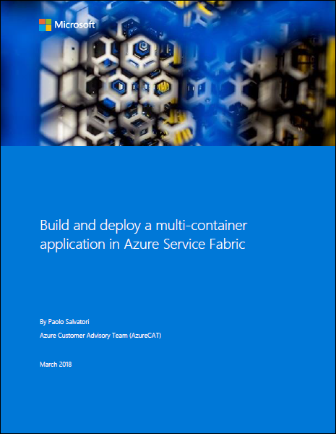
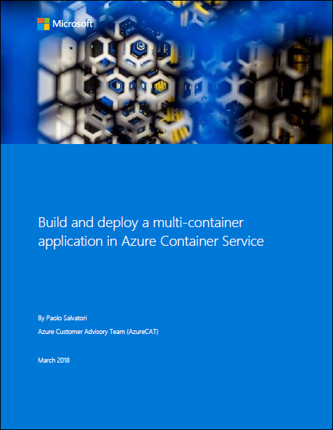
https://blogs.msdn.microsoft.com/azurecat/2018/04/17/two-new-azurecat-ebooks-build-and-deploy-a-multi-container-application-service-fabric-azure-container-service/

Slide 19
Build and deploy a multi-container application in Azure service fabric – a book from Azure Cat

Slide 20
Build and deploy a multi-container application in Azure container service – a book from Azure Cat

Slide 21
Demo-1
https://github.com/garora/talks
Notes:
Create a demo app that correlates with https://docs.microsoft.com/en-us/azure/service-fabric/service-fabric-quickstart-dotnet

Slide 22
What will we build here?
1. Application using .NET and Service Fabric
2. ASP.NET Core for web interface
3. A small voting system

Slide 23
Prerequisites
1. Visual Studio 2017
2. Azure Development, ASP.NET Web development
3. Microsoft Service Fabric

Slide 24
Demo-2
https://github.com/garora/talks
Notes:
Create a demo app that correlates with https://docs.microsoft.com/en-us/azure/service-fabric/service-fabric-quickstart-dotnet

Slide 25
What will we build here?
1. Building microservices using .NET Core with Service Fabric
2. ASP.NET Core for web interface
3. A small ticketing system

Slide 26
Prerequisites
1. Visual Studio 2017 Update 3 or later
2. Azure Development, ASP.NET Core
3. Microsoft Service Fabric

Slide 27
Demo-3
https://github.com/garora/talks
Notes:
Create a demo app that correlates with https://docs.microsoft.com/en-us/azure/service-fabric/service-fabric-quickstart-dotnet

Slide 28
What will we build here?
1. Building microservices using .NET Core with Service Fabric
2. ASP.NET Core for web interface
3. A small ecommerce system – (checkout only)
4. Mapping DevOps (using VSTS)
5. Deployment using containers

